Slide 1
EMPLOYEE SALARY PREDICTION Using mAchine learning
CAPSTONE PROJECT
Presented By:
Name: Abhisek Das
College: Trident Academy of Technology , Bhubaneswar
Dept: Computer Science and Technology
AICTE id: STU68198908a6b601746503944

Slide 2
OUTLINE
Problem Statement (Should not include solution)
System Development Approach (Technology Used)
Algorithm & Deployment (Step by Step Procedure)
Result
Conclusion
Future Scope(Optonal)
References

Slide 3
Problem Statement
Organizations and HR professionals often need to estimate whether an employee is likely to earn more or less than $50,000 per year based on their demographic and professional attributes. Manual analysis is time-consuming and prone to bias. There is a need for an automated, user-friendly tool that can predict salary class (≤$50K or >$50K) using machine learning, based on employee details such as age, education, occupation, work hours, and more.

Slide 4
System Approach
System requirements
RAM: 16GB
Disk Space: 512GB
Processor: intel i7
Windows 11
Stable internet connection

Slide 5
System Approach
Library required to build the model
.Pandas
Used for importing csv file and representing the data in the form of dataframe.
.Matplotlib
Used for data Visualization to finding the Unwanted data in the record.
.StreamLit: For webhosting

Slide 6
System Approach
Library required to build the model
.Sklearn
1. Preprocessing
StandardScaler: Scales (standardizes) the features so each has mean 0 and variance 1. Ensures all features contribute equally to the model.
LabelEncoder: Converts categorical string labels (like gender, workclass, etc.) into numeric codes.Required for machine learning algorithms that only accept numeric input.

Slide 7
System Approach
Library required to build the model
.Sklearn
2. Model Selection and Training
train_test_split: Splits the dataset into training and testing sets.
Helps evaluate model performance on unseen data.

Slide 8
System Approach
Library required to build the model
Machine Learning Models
LogisticRegression: Linear model for binary classification.
DecisionTreeClassifier: Tree-based model for classification.
RandomForestClassifier: Ensemble of decision trees for better accuracy.
SVC: Support Vector Classifier for classification tasks.
KNeighborsClassifier: Classifies based on the closest data points.
GradientBoostingClassifier: Boosting ensemble for improved performance.

Slide 9
Algorithm & Deployment
1. import the required libraries
imported the pandas library as pd for data handling and manipulation.
imported matplotlib.pyplot as plt for data visualization.
2. load the dataset
read the dataset containing employee salary information. The data has various columns like age, workclass, fnlwgt, education, educational-num, marital-status, occupation, relationship, race, gender, capital-gain, capital-loss, hours-per-week, native-country, and income.

Slide 10
Algorithm & Deployment
3. explore the dataset
viewed the first few rows of the data to understand the columns and the types of values present.
4. clean or preprocess the data
I identify and handle missing values or placeholder values (for example, "?" is changed to "Others" or "Unknown" in certain categorical columns).
I drop unnecessary columns if needed, such as fnlwgt, which is typically not useful for income prediction.
I ensure correct data types for each column.

Slide 11
Algorithm & Deployment
5. encode categorical variables
I transform categorical variables (like workclass, occupation, and gender) into numerical format so machine learning models can work with them.
For some categorical columns, I use label encoding; for others, I may use one-hot encoding, depending on the data and model requirements.
I also check to make sure that values like "Others" and "Unknown" are correctly handled during this process.

Slide 12
Algorithm & Deployment
6. select the features and target
decided which columns will be input features (such as age, educational-num, hours-per-week, etc.) and which column will be the target variable (income, in this case).
7. split the data
split my cleaned and encoded data into training and testing sets so I can train my model on one part and evaluate its performance on unseen data.
8. train a model
select an appropriate machine learning model used the training data to fit the model.

Slide 13
Algorithm & Deployment
9. evaluate the model
I test the trained model on the test data and calculate performance metrics such as accuracy, precision, and recall to assess how well my model predicts employee income.
10. visualize the results
I use matplotlib to plot charts or graphs, such as the distribution of a feature or model performance metrics, to better understand the results.
11. interpret and report findings
I analyze the output and note which factors are most influential in predicting income based on the model results and feature importances.

Slide 14
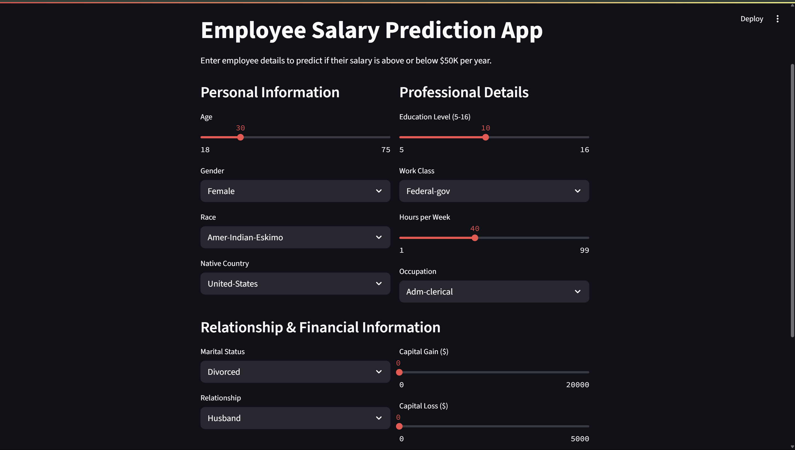
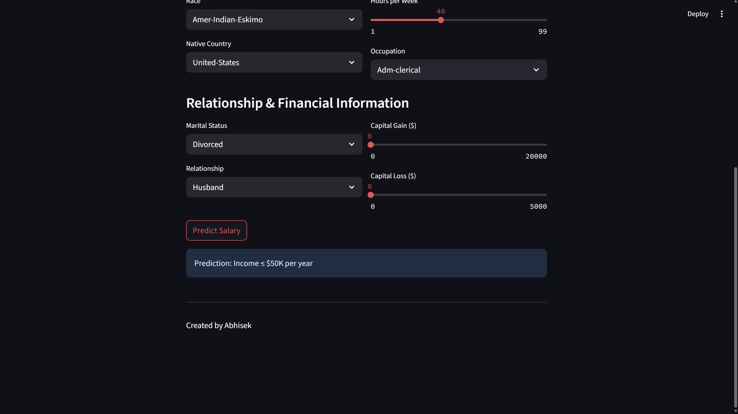
Result
Attach your Github link
https://github.com/AbhisekDas01/Employee-Salary-Prediction-App.git

Slide 15
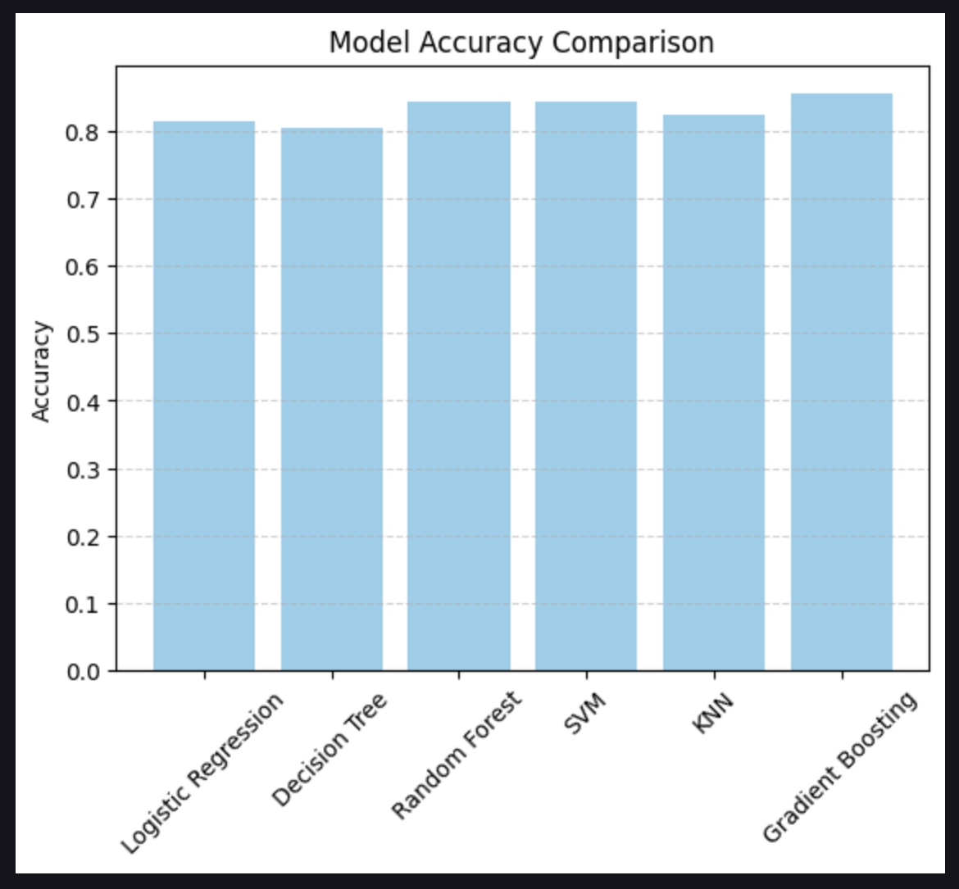
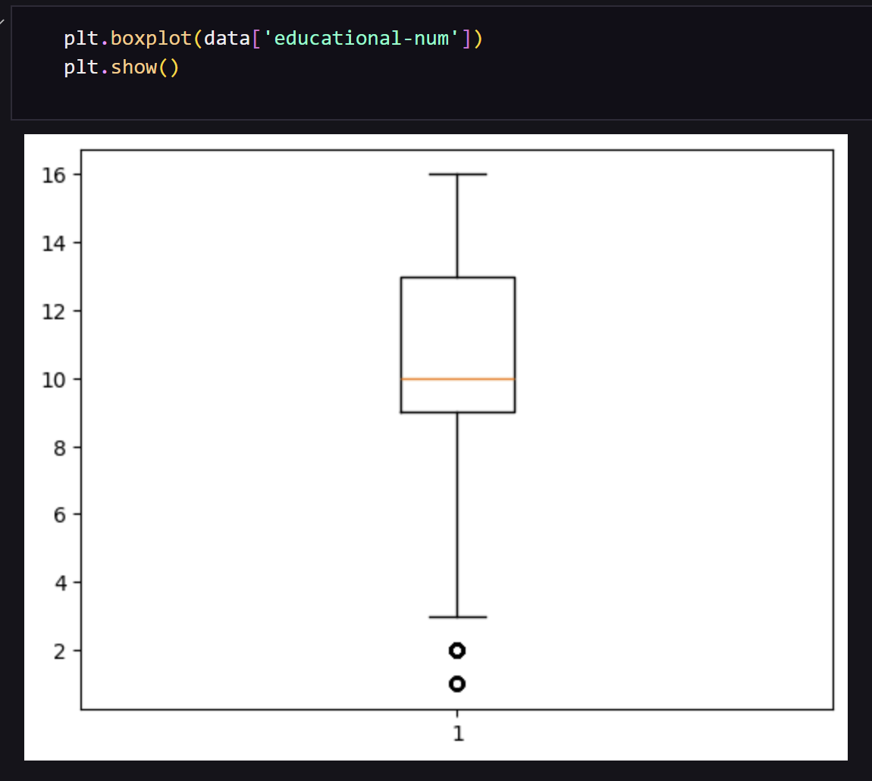
Result

Slide 16
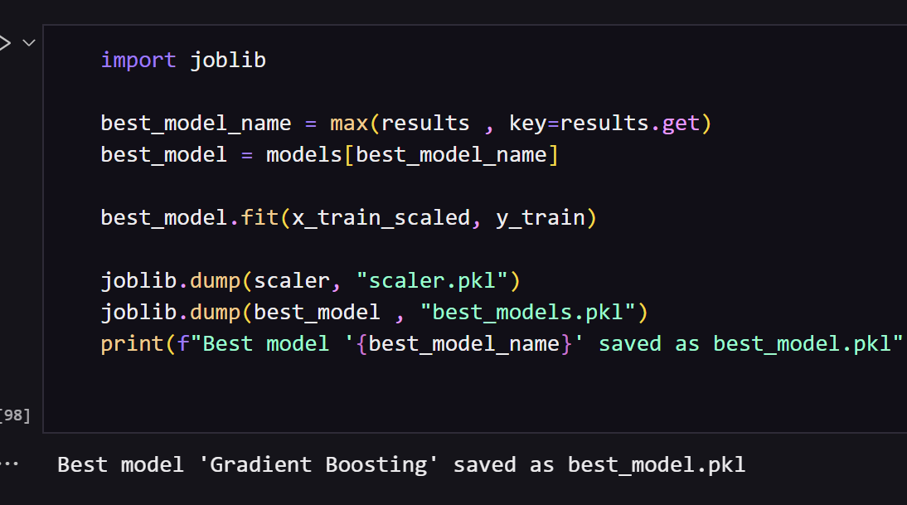
Result

Slide 17
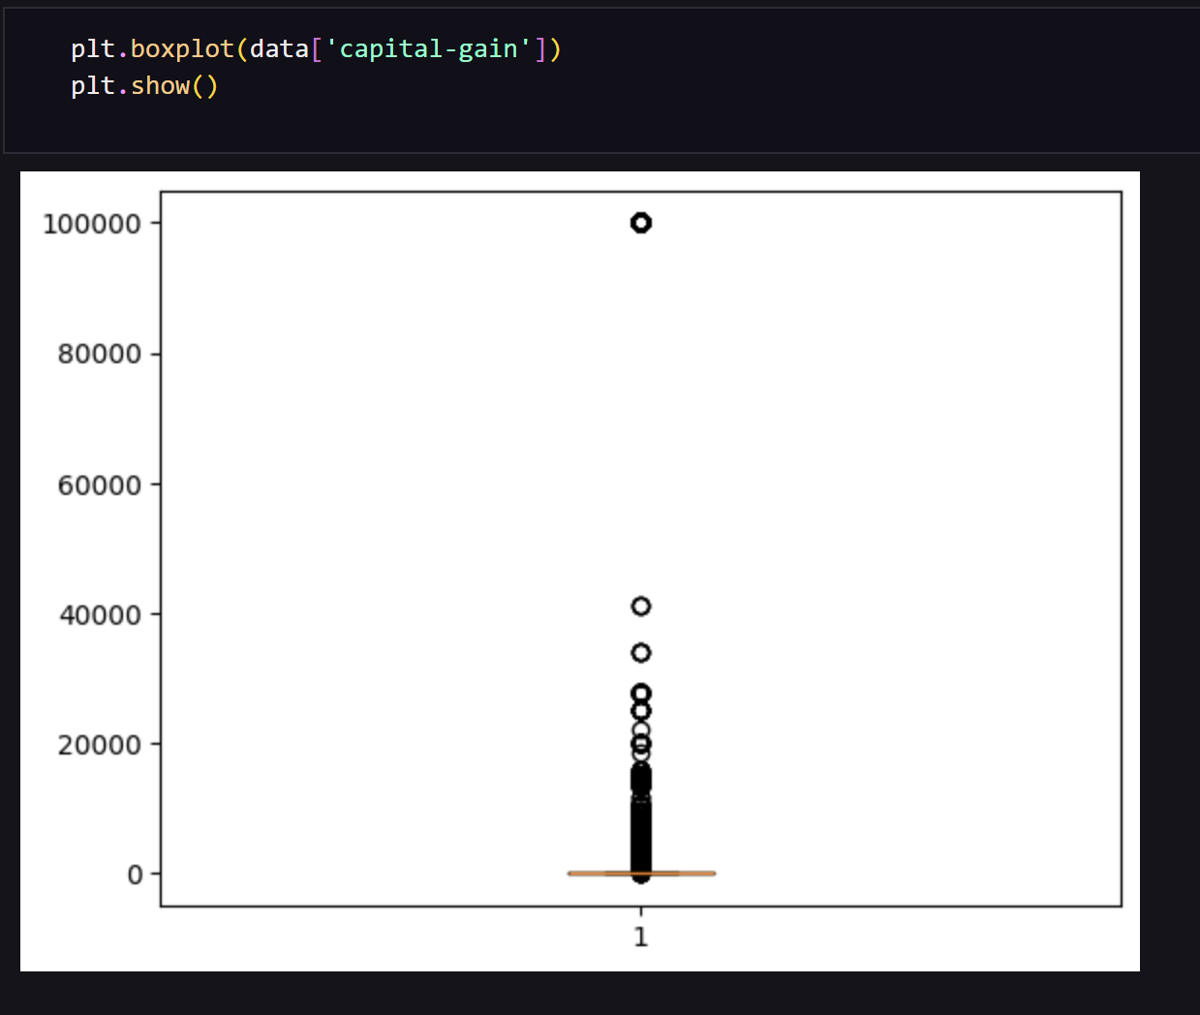
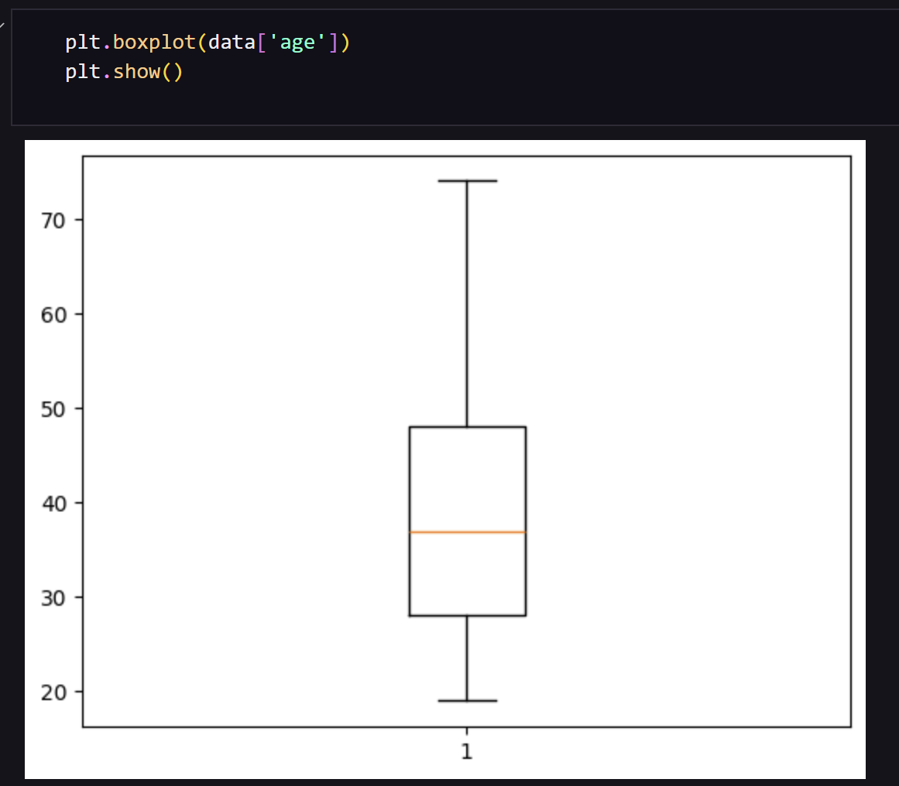
Result

Slide 18
Conclusion
The project aimed to predict employee income using a Machine learning algorithm. The data was cleaned by replacing missing values, dropping irrelevant columns, and encoding categories into numbers. After training and testing the model, it showed good accuracy in classifying income as above or below 50K.
Some challenges included handling missing values marked as "?" and converting categorical data correctly. To improve the model, techniques like one-hot encoding, parameter tuning, or using ensemble models like Random Forest can be applied.

Slide 19
Future scope(Optional)
Discuss potential enhancements and expansions for the system.

Slide 20
References
scikit-learn
Stream-lit
Adult3.csv (training data)

Slide 21
THANK YOU

